Slide 1
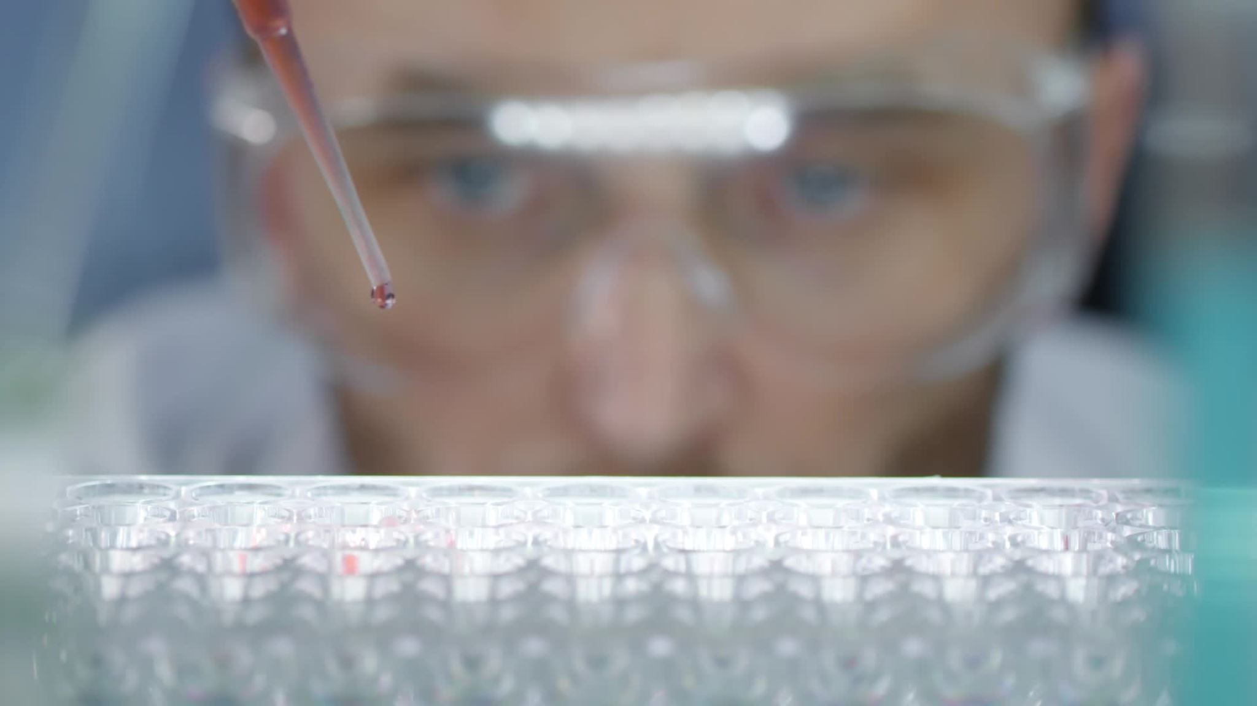
Detection of Surgical Instruments Using Faster R-CNN
& YOLO: An Enhanced Approach
Authors:
Shubham Laxmikant Deshmukh,
Pradyumna Kombethota Ramgopal
CS 5814 Instructor and Mentor:
Prof. Chandan Reddy

Slide 2

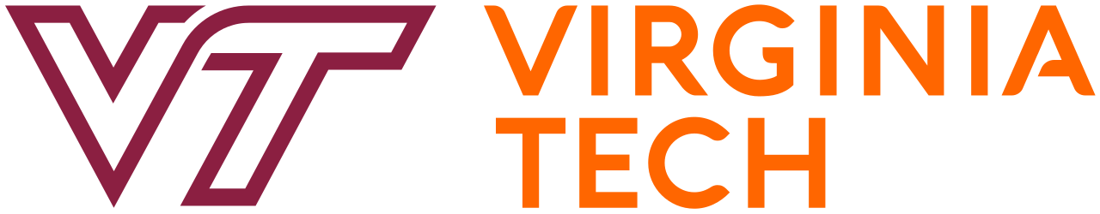
Agenda
Problem Statement
Data Description
Model/ Architecture Design
Evaluation
Lessons Learned
Broader Impacts
References

Slide 3
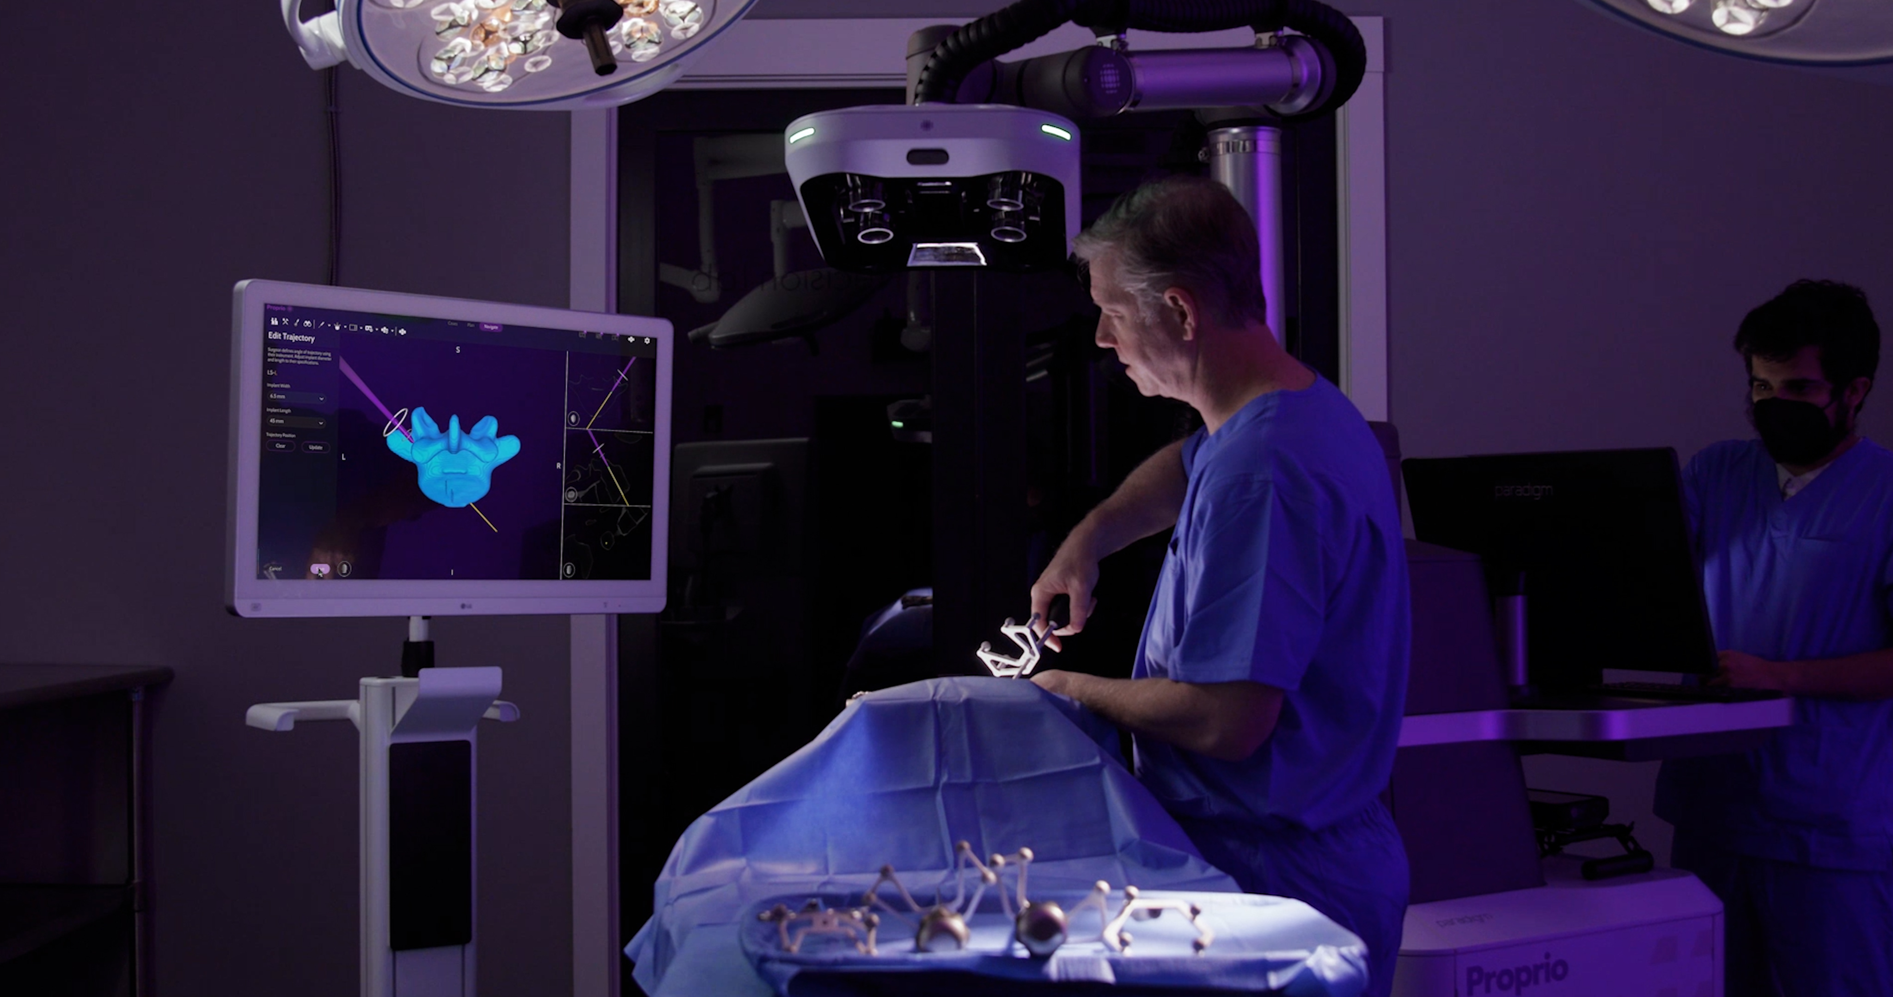
Problem Statement
Surgical Assistance Challenges: Need for accurate and real-time detection of surgical instruments during procedures.
Importance: Enhancing operational precision, ensuring patient safety, and automating surgical workflows.
Limitations of Existing Methods:
Conventional feature-based and machine learning approaches lack accuracy and speed in complex surgical environments.
Challenges in detecting multiple instruments simultaneously or under occlusion and variable conditions.
Objective: Evaluate advanced object detection models (Faster R-CNN and YOLOv8) for neurosurgical instrument detection to improve accuracy and real-time performance.

Slide 4
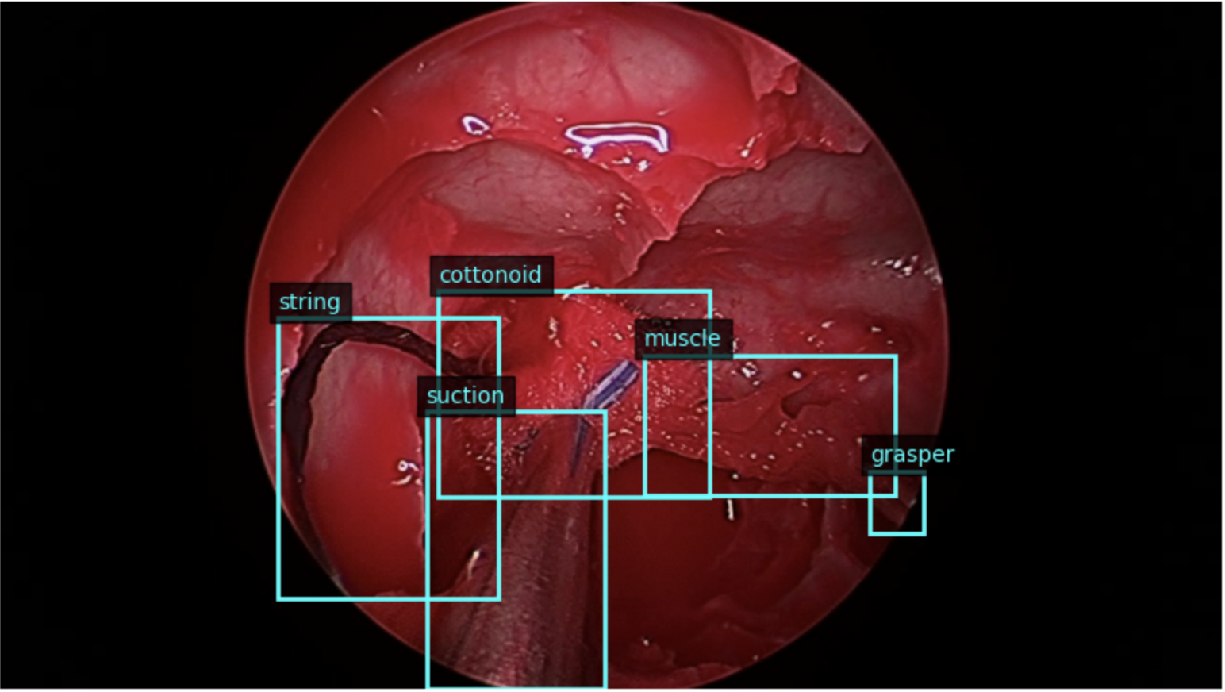
Data Description
Dataset: SOCAL (Simulated Outcomes Following Carotid Artery Laceration).
Size: 31,443 annotated frames from 147 video trials.
8 Classes: Cottonoid, Drill, Grasper, Muscle, Scalpel, String, Suction, Tool.
Format: JPEG images with bounding boxes in CSV.
Challenges: Variable instrument positions, lighting, occlusions, and overlapping tools.
Preprocessing:
Converted annotations to COCO format.
Bounding boxes labeled with class label, x, y, width, and height.
Training Data: 960 images; Validation Data: 220 images.
Fig 1. A sample image with bounding boxes and labels.

Slide 5
Model/ Architecture Design
Evaluated two state-of-the-art object detection models: Faster R-CNN and YOLOv8.
Goal: Detect surgical instruments with high accuracy and real-time efficiency.
Common Techniques
Transfer Learning: Pre-trained on the COCO dataset, fine-tuned for 8 surgical tools.
Data Augmentation: Scaling, rotation, flipping, brightness, and contrast adjustments.
Training Optimization:
Learning rate scheduling.
Momentum and weight decay for stability and generalization.

Slide 6
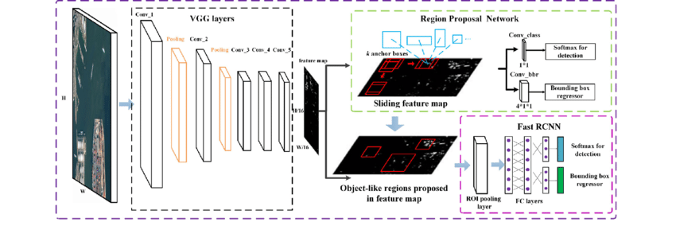
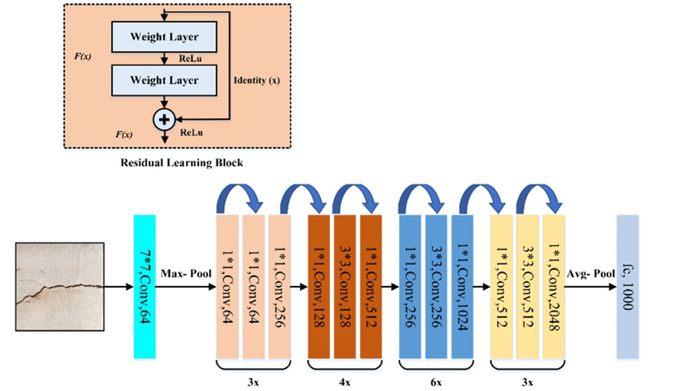
Faster R-CNN
Type: Two-stage object detection framework.
Architecture:
Backbone: ResNet-50 with Feature Pyramid Network (FPN) for multi-scale feature extraction.
Region Proposal Network (RPN): Generates potential object regions using anchor boxes.
RoI Align: Aligns proposals to fixed sizes for precise feature extraction.
Classification & Regression: Refines bounding box coordinates and assigns object labels.
Training:
Optimizer: Stochastic Gradient Descent (SGD).
Hyperparameters: Learning rate: 0.005, Momentum: 0.9, Weight Decay: 0.0005.
Early stopping to prevent overfitting.
Advantages: High precision, suitable for complex and overlapping objects.
Limitation: Slower inference speed, less suited for real-time detection.
Fig 2. Faster R-CNN architecture.
Fig 3. ResNet-50 architecture.

Slide 7
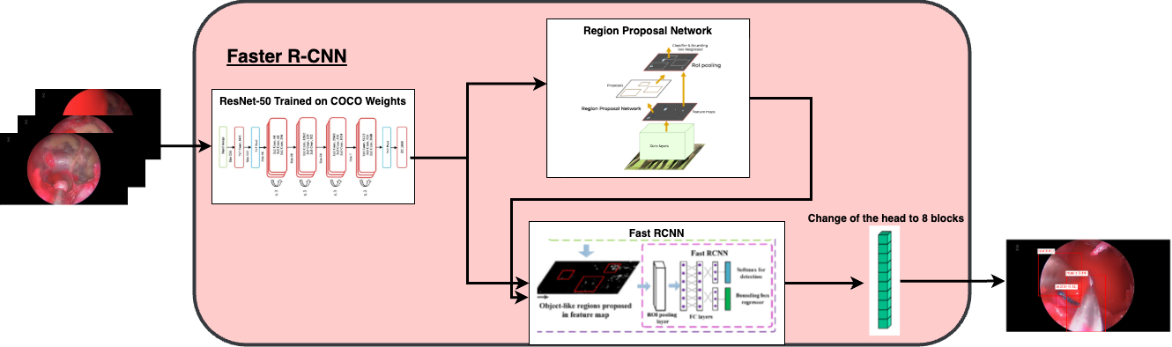
Faster R-CNN
Our model used for training using Transfer Learning technique:

Slide 8
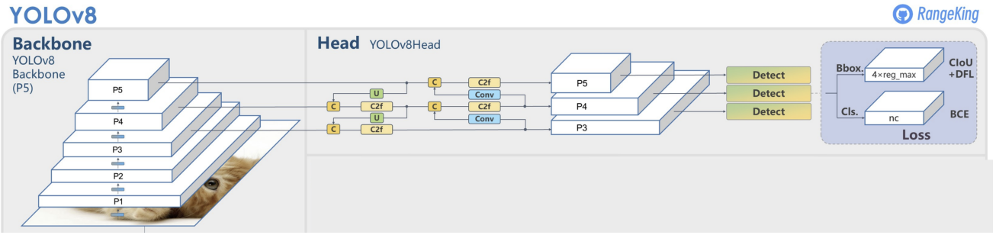
YOLO v8
YOLO Process:
Feature Extraction: Input image is processed through a CNN to extract essential features.
Class and Bounding Box Predictions: Fully connected layer predict object classes and bounding box coordinates.
Intersection over Union (IoU): Measures the alignment between predicted and ground truth bounding boxes.
Non-Max Suppression (NMS): Eliminates overlapping boxes, retaining only the most confident predictions.
Fig 4. YOLOv8 Architecture
Architecture:
Backbone: CNN responsible for extracting features from the input image
Neck: Merges feature maps from different stages of the backbone to capture information at various scales.
Head: The head is responsible for making predictions.

Slide 9
Training
Optimizer: AdamW
Hyperparameters: Learning rate: 0.0008, Momentum: 0.9
Advantages: Real-time detection, and high accuracy
Limitations: Struggles with small/occluded objects, and resource-intensive training.

Slide 10
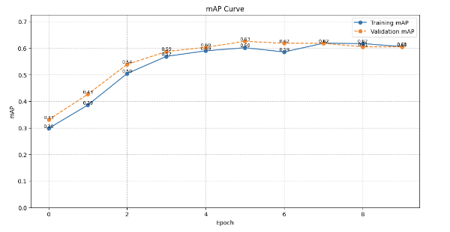
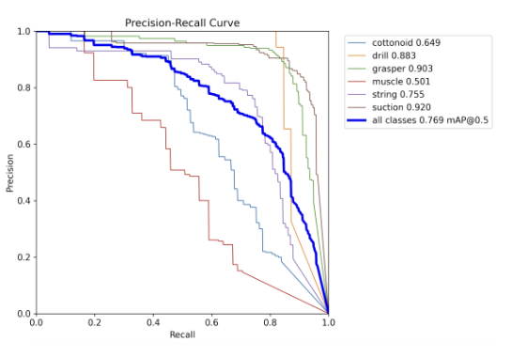
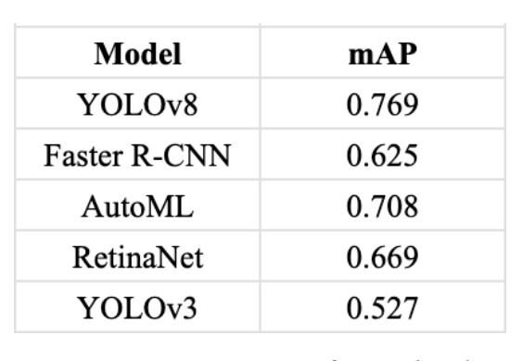
Evaluation
Faster R-CNN model achieved a mAP of 0.625, Precision of 0.32, Recall of 0.32, F1-Score of 0.31.
YOLOv8 model achieved a mAP of 0.769, Precision of 0.788, Recall of 0.722, F1-Score of 0.75.
Fig. 6 mAP for Faster R-CNN
Fig. 8 Comparative mAP scores of various object detection models
Fig. 7 mAP for YOLOv8

Slide 11
Lessons Learned
Model Trade-offs: Faster R-CNN offers good precision but is slower, while YOLOv8 excels in speed and real-time detection but struggles with smaller or occluded objects.
Importance of Dataset Quality: Dataset biases and underrepresented classes (e.g., scalpel) significantly impact model performance and generalizability.
Transfer Learning Effectiveness: Leveraging pre-trained weights from COCO improved efficiency and accuracy, reducing computational costs for training.
Challenges in Real-world Applications: Complex surgical environments (e.g., occlusions, overlapping instruments) demand robust models capable of adapting to variability.
Potential of Advanced Architectures: Exploring hybrid models or advanced architectures like Vision Transformers and EfficientDet may further enhance detection capabilities.
Scalability: The models are adaptable to additional surgical tools or other medical imaging applications, highlighting their versatility.

Slide 12
Broader Impacts
Enhancing Surgical Precision: Real-time detection reduces human errors and improves patient outcomes.
Automation in Surgery: Supports automated workflows with real-time feedback for surgeons.
Robust Performance: Handles challenging conditions like occlusions, lighting variability, and overlapping instruments.
Scalability: Models can detect additional tools or adapt to other medical imaging tasks.
Future Prospects:
Integration with robotic-assisted surgeries.
Enhanced datasets for improved generalization.
Development of hybrid models combining Faster R-CNN and YOLO strengths.
Explore advanced architectures like Vision Transformers (ViT) and EfficientDet for better accuracy and efficiency.

Slide 13
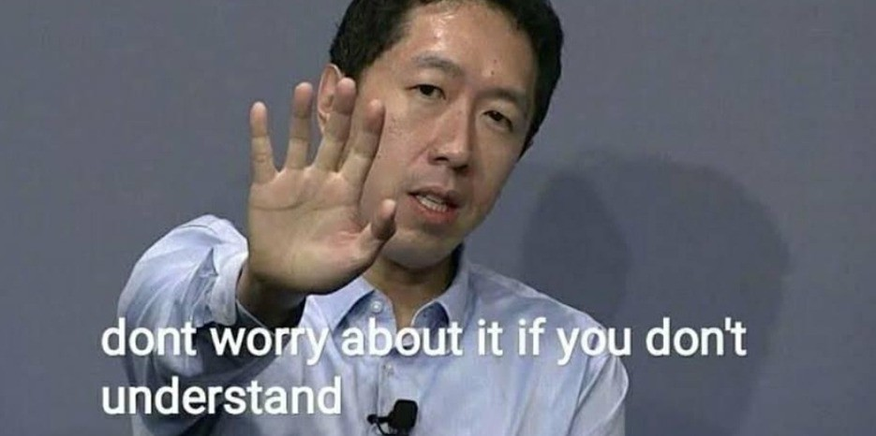
Thank You!
Got any questions for us?

